Slide 1


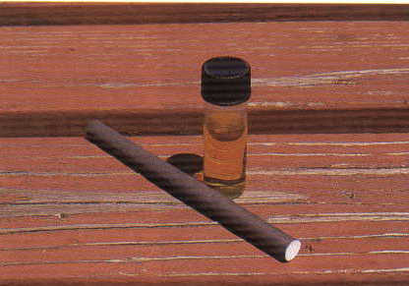
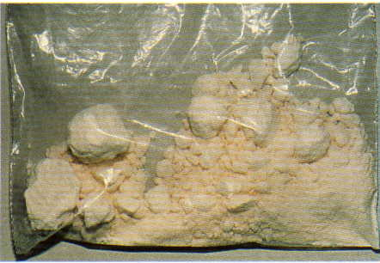
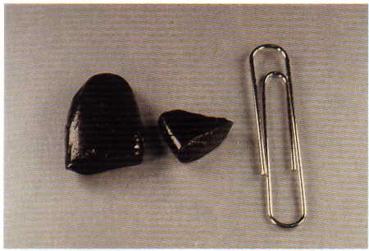



Session 7
The Effects of Drug Combinations

Slide 2
Learning Objectives
  Describe the prevalence of drug and alcohol use (individually and in combination) as well as polydrug impairment
  Define polydrug impairment
  Articulate possible effects of polydrug impairment related to indicators of alcohol and drugs

Slide 3

Prevalence of Drug Combinations

Slide 4
Polydrug
Being under the combined influence of two or more different drugs

Slide 5
Potential Effects of Polydrug Use
  Null Effect
  Overlapping Effect
  Additive Effect
  Antagonistic Effect

Slide 6
Null Effect
If neither drug affects some particular indicator of impairment, their combination also will not affect that behavior.
+
=
Nothing
Nothing
Nothing

Slide 7
Null Effect Examples
Narcotic Analgesic
Typically cause:
HGN - None
VGN - None
LOC - None
CNS Stimulant
Typically cause:
HGN - None
VGN - None
LOC - None

Slide 8
Overlapping Effect
If one drug affects some particular indicator of impairment and another does not, their combination also will affect that behavior.
+
=
Action
Nothing
Action

Slide 9
Overlapping Effect Examples
Narcotic Analgesic
Typically cause:
HGN - None
VGN - None
LOC - None
Pupil Size - Constricted
CNS Depressant
Typically cause:
HGN - Present
VGN - Possibly Present
LOC - Present
Pupil Size - Normal

Slide 10
Likely Effects of the Combination
  HGN - Present
  VGN - Possibly Present
  LOC - Present
  Pupil Size - Constricted
+
=
Action
Nothing
Action

Slide 11
Additive Effect
If both drugs affect some particular indicator of impairment, their combination also will affect that behavior.
+
=
Action
Action
Greater Action

Slide 12
Additive Effect Examples
Alcohol
Typically cause:
HGN - Present
VGN - Possibly present
LOC - Present
Pupil Size - Normal
CNS Depressant
Typically cause:
HGN - Present
VGN - Possibly Present
LOC - Present
Pupil Size - Normal

Slide 13
Antagonistic Effect
When two drugs affect some indicator in opposite ways, their combined effect will be unpredictable.
Effects will be dependent on which drug is more dominant in the system at any given time.
+
Opposite Action
=
Action
Unpredictable

Slide 14
Antagonistic Effect Examples
CNS Stimulant
Typically cause:
HGN - None
VGN - None
LOC - None
Pupil Size - Dilated
Narcotic Analgesic
Typically cause:
HGN - None
VGN - None
LOC - None
Pupil Size - Constricted

Slide 15
Combination
Dissociative Anesthetic and Narcotic Analgesic
Impairment Indicators | Effect due to Dissociative Anesthetic | Effect due to Narcotic Analgesic | Type of Combined Effect | Expected Results
HGN | Present | None | Overlapping | Present
VGN | Present | None | Overlapping | Present
LOC | Present | None | Overlapping | Present
Pupil size | Normal | Constricted | Overlapping | Constricted

Slide 16
Combination
Cannabis and Stimulant
Impairment Indicators | Effect due to Cannabis | Effect due to Stimulant | Type of Combined Effect | Expected Results
HGN | None | None | Null | None
VGN | None | None | Null | None
LOC | Present | None | Overlapping | Present
Pupil size | Dilated*** | Dilated | Additive | Dilated
***May be normal

Slide 17
Drug Combination Factors
The actual effects can depend on a number of factors including, but not limited to:
  Dose levels
  Time of administration
  An individual’s metabolism

Slide 18
Questions?

